Slide 1
Machine Learning & Deep Learning

Slide 2
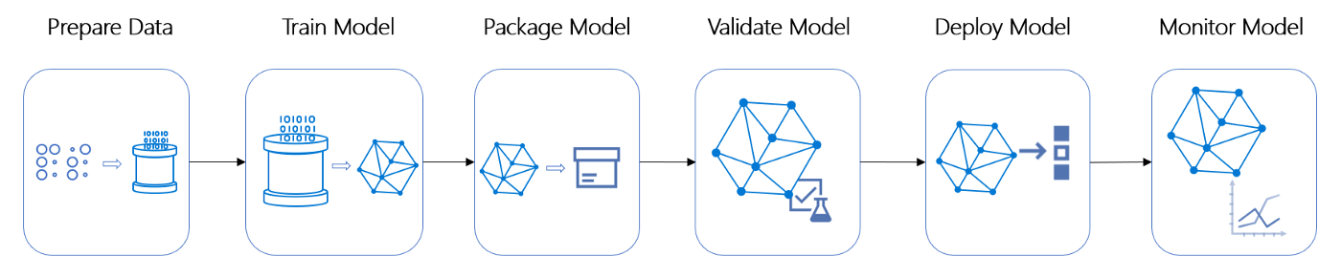
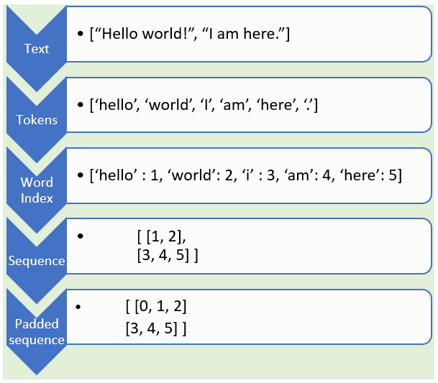

Slide 3
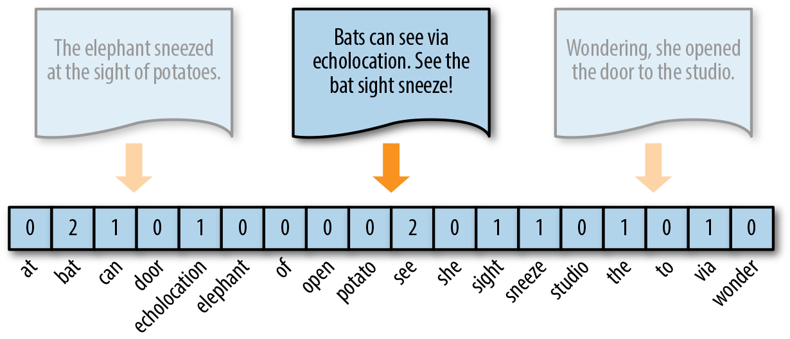
Text to vector
Select a data type and objective
Adjusting parameters
Furtherer Data Cleaning
-Train/Test Split
-Normalize
Notes:
1.Different data type to use different algo, some models will work better for detecting picture, and some are for text. For objective, it is what output you want. types of outputs including classification, regression, and predicting the trend.
3.
有些新闻有更多feature

